Slide 1
Comp 4350 Software Engineering II Lecture 9
Dr. Shaowei Wang

Slide 2
Outline
Test coverage
Applications for testing coverage
Faulty localization
Mutation testing

Slide 3
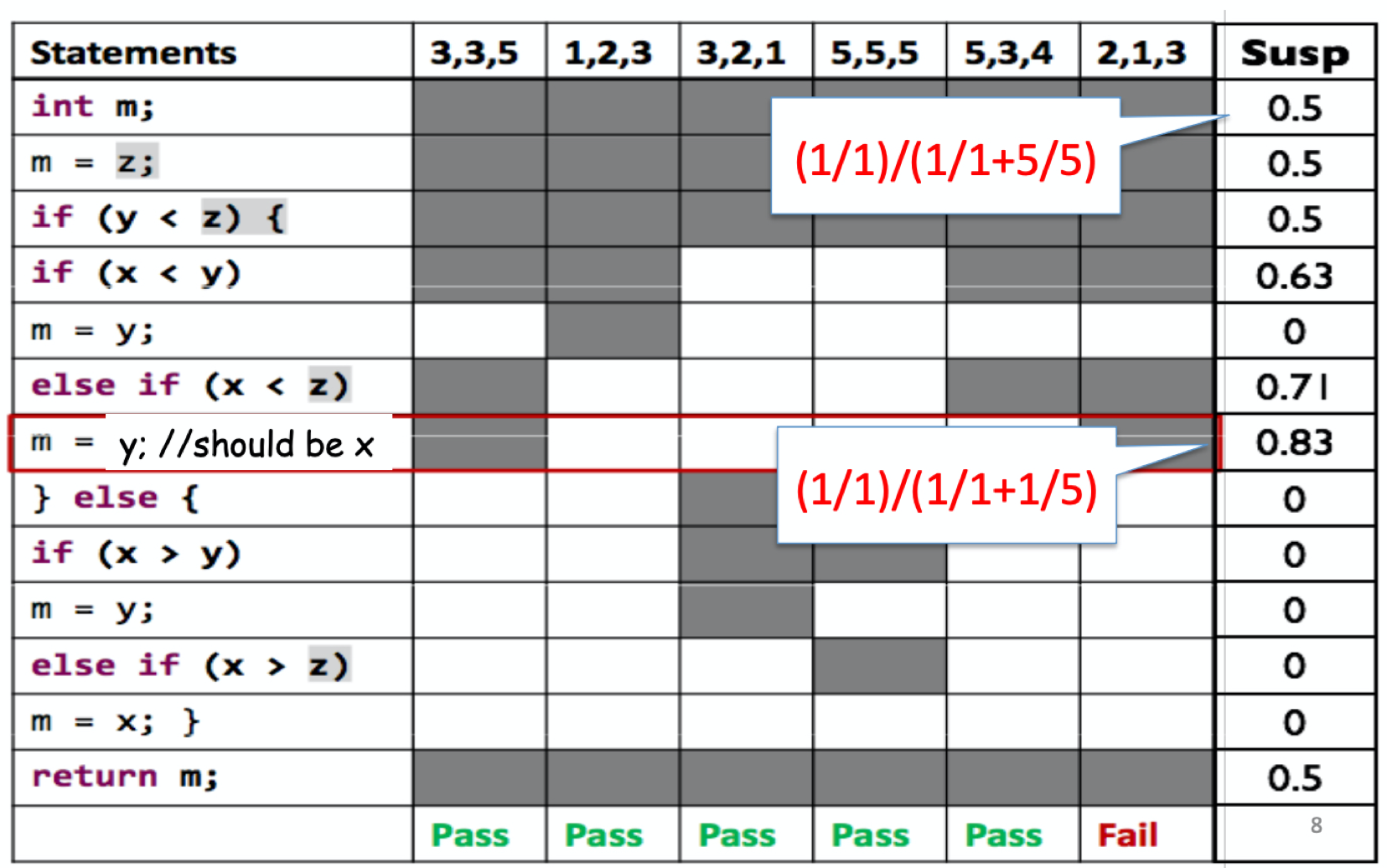
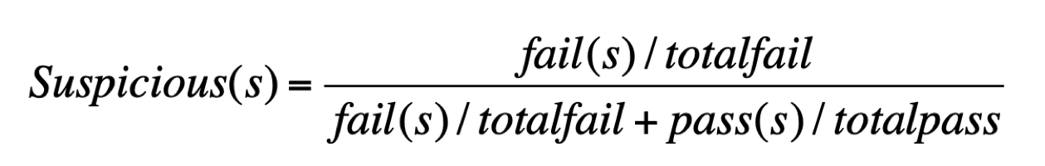
An Example of Using Tarantula
Running on all the pass cases.
Only running on 1/5 of the pass cases.
Notes:
Tarantula: https://github.com/prove/tarantula
Tarantula is modern tool for managing software testing in agile software projects. It's free, licensed as open source software under GNU GPLv3.
www.testiatarantula.com

Slide 4
Outline
Test coverage
Applications for testing coverage
Faulty localization
Mutation testing

Slide 5
Mutation testing

Slide 6
Measuring Test Cases
What we have learned so far?
Quantitatively measure how much code is covered by test cases?
Do the coverage metrics directly measure the effectiveness of test cases (where your test case could detect bug)?
No.

Slide 7
Test Case Effectiveness
Detecting bug is the most effective way to measure test case.
Test suite A can detect more bugs than test suite B.
Given one bug, some test cases in suite A fail, but all test cases in suite B pass.
The best test suite can detect every bug; whenever a bug is introduced, at least one test case will fail.

Slide 8

What if we manually inject bugs and let the test cases to detect?

Slide 9
Mutation testing
Mutation testing
Artificially inject bugs by modifying (mutating) some statements in the code, so we have many different versions of the code. Each version has a bug.
Check if the test cases can find the bugs, i.e., some test cases fail and some do NOT fail.
Notes:
The metrics we covered so far are based on the contents we can obtain in software, whether requirements, code implementation,

Slide 10

int max(int x, int y){
int Max;
if (x > y)
Max = x;
else
Max = y;
return Max;
}
int max(int x, int y){
int Max;
if (x > y)
Max = x;
else
Max = x; // mutant
return Max;
}
Input sets:
{x=3, y=2;} => return 3 => cannot detect bug
{x=3, y=2; x=2, y=3} => always return 2, detect the bug
Notes:
First, what is the bug in the above code?
Which input set will find the bug?
Why?
More coverage!
Coverage is a measure of how many execution branches are touched by your test suite

Slide 11
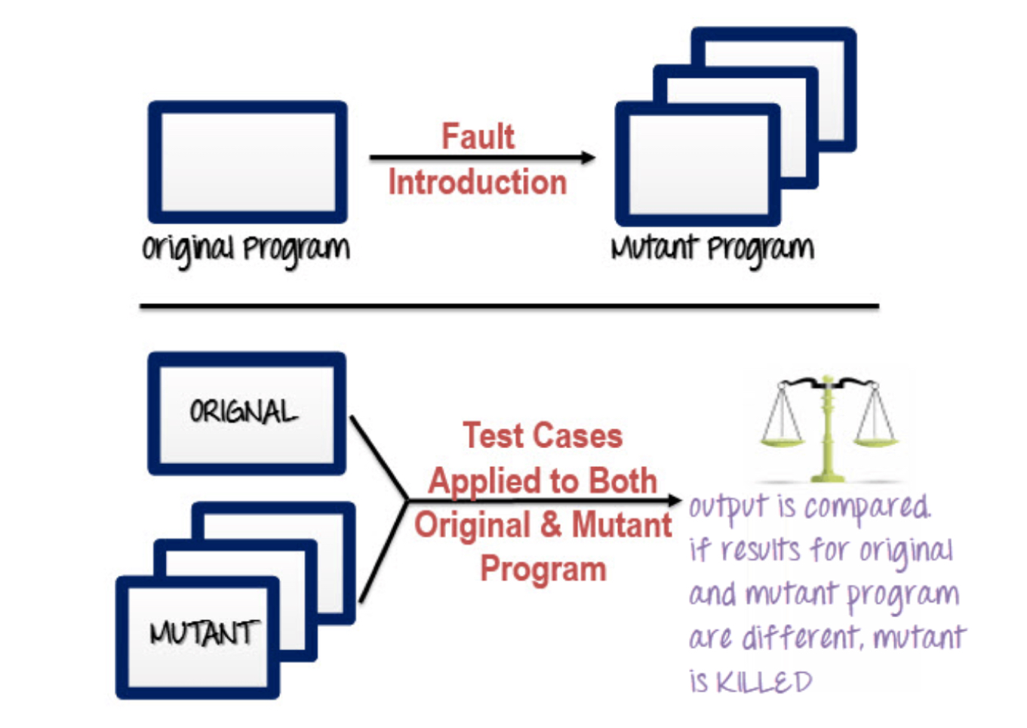
Steps in Mutation Testing
Input: an original program and a target test suits
Step 1: Modify statements in the original program and create a number of variates (i.e., mutants).
E.g., “z = y + x” is modified to “z = y - x”
“if (x >= y)” is modified to “if (x > y)”, and vice versa.
Step 2: Test cases are run through the each generated mutant.
Step 3: Compare the results of the original and the mutant.
Step 4:
=>The mutant is killed if different results are found (i.e., dead mutant). The test suite is good as it detects the change (i.e., injected defect).
=> The mutant is alive if the results are the same: the test suite is NOT effective.

Slide 12
Mutation Testing
For the automated generation of mutants, we use mutation operators, i.e., predefined program modification rules (corresponding to a fault model)
Notes:
12

Slide 13


Simple Example – mutation operations
Original code: Mutants:
Δ1 minVal = b;
int min(int a, int b) {
int minVal = a;
if (b < a) {
minVal = b;
}
return minVal;
}
Δ2 if (a < b) {
Δ3 if (b < minVal) {
Δ4 bomb();
Δ5 minVal = a;
one mutant = one syntactic change introduced at a time
Notes:
13

Slide 14
Specifying Mutation Operators
Ideally, we would like the mutation operators to be representative of (and generate) all realistic types of faults that could occur in practice
Mutation operators change with programming languages, design and specification paradigms (much overlap though)
In general, the number of mutation operators is large as they are supposed to capture all possible syntactic variations in a program
Notes:
14

Slide 15
Example of Mutation Operators
Statement deletion
Statement duplication
Statement insertion
Replacement of Boolean expressions with true or false
Replacement of arithmetic operations with others (e.g., + with *, - with /)
Replacement of conditional expressions (e.g., > with ≥, == with ≤)
Negation of conditional expressions
Replacement of variables (must be type compatible)
Replacement of constant with variable or vice versa
Replacement of array reference with constant or variable or vice versa
Replace increments with decrements or vice versa
Replace constructor calls with null
Replacement of return statement
For a compete list supported by the Pitest tool: see http://pitest.org/quickstart/mutators/
Notes:
15

Slide 16
Example of Mutation Operators
Specific to object-oriented programming languages:
Replacing a type with a compatible subtype (inheritance)
Changing the access modifier of an attribute or method
Changing the instance creation expression (inheritance)
Changing the order of parameters in the definition of a method
Changing the order of parameters in a call
Removing an overloading method
Reducing the number of parameters
Removing an overriding method
Notes:
16
Removing an overloading method -> see if your test cases cover the overloading method?

Slide 17
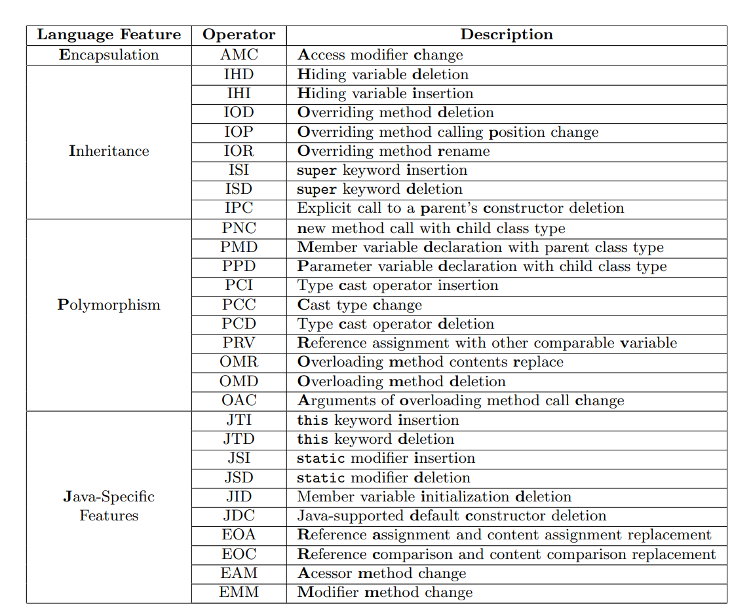
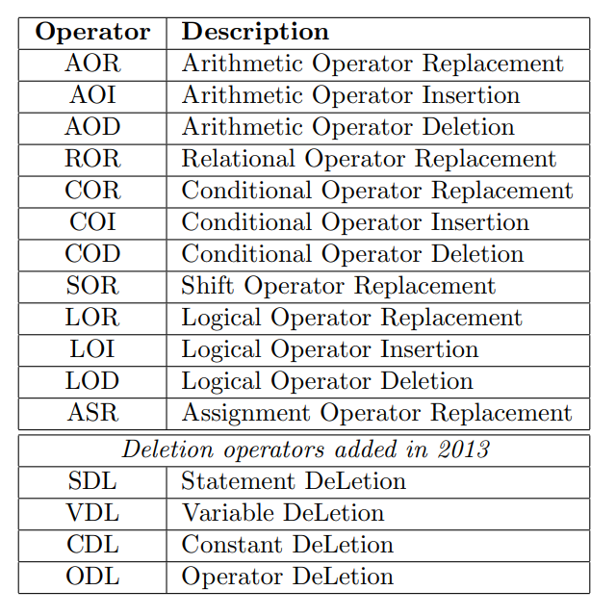
Mujava
Class level mutation
Method level mutation
https://cs.gmu.edu/~offutt/mujava/

Slide 18
Type of mutation testing
Statement mutation
developer cut and pastes a part of a code of which the outcome may be a removal of some lines
Value mutation
values of primary parameters are modified
Decision mutation
Control statement are to be changed

Slide 19
Mutation coverage
Mutation Score = 100 * D / N
D: Dead mutants (killed mutants)
N: Number of mutants
A set of test cases is mutation adequate if its mutation score is 100%.
Number of mutants tends to be large, even for small programs.
If not all mutants are killed, enhance your test suit.
Notes:
19

Slide 20


Why some mutants still remain live?
Notes:
20

Slide 21
Why some mutant still remain live?
The test set is inadequate to kill the mutant (the test set does not cover the modified spots). For this case, the test data need to be re-examined, possibly augmented (increase test set) to kill the live mutant
Notes:
21

Slide 22
int max(int x, int y){
int Max;
if (x > y)
Max = x;
else
Max = y;
return Max;
}
int max(int x, int y){
int Max;
if (x > y)
Max = x;
else
Max = x; // mutant
return Max;
}
Input sets:
{x=3, y=2;} => return 3 => cannot detect bug, because the mutated statement is not executed.
Notes:
First, what is the bug in the above code?
Which input set will find the bug?
Why?
More coverage!
Coverage is a measure of how many execution branches are touched by your test suite

Slide 23
Why some mutant still remain live?
The test set is inadequate to kill the mutant (the test set does not cover the modified spots). For this case, the test data need to be re-examined, possibly augmented (increase test set) to kill the live mutant
It is equivalent to the original program (functionally identical though syntactically different – equivalent mutant)
Notes:
23

Slide 24
Example – Equivalent mutants
Original code: Mutants:
int min(int a, int b) {
int minVal = a;
if (b < a) {
minVal = b;
}
return minVal;
}
Δ2 if (b < minVal) {
Replace a with minVal, does not change the semantic of the program since minVal = a;
Notes:
24

Slide 25
Mutation coverage
Mutation Score = 100 * D / (N - E)
D: Dead mutants (killed mutants)
N: Number of mutants
E: Number of equivalent mutants
However, detecting equivalent mutants is challenging.
Use constraints to Detect Equivalent Mutants
Notes:
25
Mathematical constraints to automatically detect equivalent mutants [56], [59] (1996)
Program slicing to assist in the detection of equivalent mutants [25] (1999)

Slide 26
Example – Equivalent mutants
Original code: Mutants:
int min(int a, int b) {
int minVal = a;
if (b < a) {
minVal = b;
}
return minVal;
}
Δ2 if (b < minVal) {
Maintain a constraints {minVal = a}
Notes:
26

Slide 27
Mutation coverage
Mutation Score = 100 * D / (N - E)
D: Dead mutants (killed mutants)
N: Number of mutants
E: Number of equivalent mutants
However, detecting equivalent mutants is challenging.
Use constraints to Detect Equivalent Mutants
Avoid generating equivalent mutants
Notes:
27
Mathematical constraints to automatically detect equivalent mutants [56], [59] (1996)
Program slicing to assist in the detection of equivalent mutants [25] (1999)

Slide 28
Example – Equivalent mutants
Original code: Mutants:
int min(int a, int b) {
…
int x = y +x;
…
x = 0; /*re-initialize */
…
return x;
}
x = y-x;
Any mutant on the assignment of x before x=0 would cause equivalent mutant.
Use data dependency to know the scope of variable values can reach a particular program point
Notes:
28

Slide 29
Assumptions for mutation testing
What about more complex errors, involving several statements?
Competent programmer assumption: most software faults introduced by experienced programmers are due to small syntactic errors
Coupling effect assumption: simple changes can lead to complex errors
Notes:
29

Slide 30
Different Mutants
Equivalent mutant: always produces the same output as the original program
Stillborn mutant: syntactically incorrect, killed by compiler
Notes:
30
We are not only to measure our test cases, but also find opportunity to enhance our test cases.

Slide 31
Example - Stillborn mutant
Original code: Mutants:
int min(int a, int b) {
int minVal = a;
if (b < a) {
minVal = b;
}
return minVal;
}
Δ6 minVal = ToString(b);
Return type of failOnZero() is String
Notes:
31

Slide 32
Different Mutants
Equivalent mutant: always produces the same output as the original program
Stillborn mutant: syntactically incorrect, killed by compiler
Trivial mutant: killed by almost any test case (i.e., covered by every test case)
Notes:
32

Slide 33
Example - Trivial mutant
Original code: Mutants:
public int getMin ( int [] numbers ) {
int min = numbers [0];
for ( int i =1; i < numbers.length; ++ i ) {
if (numbers[i] < min) {
min = numbers [ i ];
}
}
return min ;
}
Return 0;
A=[1,2,3,4,5] fail
B=[1,1,3,56,0] fail
Notes:
33
The program will fail for all test case. It’s good to generate some mutants that cause a portion of failures and portion of pass.

Slide 34
What is the condition for a test case to trigger a mutant?
Reachability: reach the fault seeded (mutated code) during execution
E.g., one branch is not covered
Infection: Cause the program state to be incorrect
E.g., equivalent mutant
Propagation Cause the program output to be incorrect
E.g., the incorrect state is re-initialized
Notes:
34
Condition

Slide 35
1. int min(int A, int B)
2. { // original
int minVal;
minVal = A;
if (B < A) {
6. minVal = B;
7. }
8. return minVal;
9. }
1. int min(int A, int B)
2. { // mutant
int minVal;
4.1 minVal = B;
if (B < A) {
4. minVal = B;
}
return minVal;
7. }
Replace one varirable
with another
Reachability: unavoidable
Infection: need B != A
Propagation: wrong minVal needs to return to the caller; that is we cannot execute the body of the if statement, so need B >= A
Test case => B>A
Notes:
That is said, if your test suite doesn’t have adequate test cases, some mutant will not be killed.

Slide 36
Example –use mutation testing to enhance test cases
The program prompts the user for a positive number in the range of 1 to 20 and then for a string of that length. The program then prompts for a character and returns the position in the string at which the character was first found or a message indicating that the character was not present in the string.
The user has the option to search for more characters.
FindPos(x, a, c){
//a is the given string, x is the length of a, c is the target character
…
if (x > 20 || x<1)
print(“input integer between 1 and 20”)
found := FALSE;
i := 1;
x = sizeof(a)
while(not(found) and (i ≤ x)) do
begin
if a[i] = c then
found := TRUE
else
i := i + 1
end
…
}
Notes:
36
We are not only to measure our test cases, but also find opportunity to enhance our test cases.

Slide 37
Test Cases
x is the length of the string
a is the string
c is the character we are looking for
Response indicates whether we want to continue the search
Notes:
37

Slide 38

Mutant 1
Re-run original test data set
Original code:
FindPos(x, a, c){
…
if (x > 20 || x<1)
print(“input integer between 1 and 20”)
found := FALSE;
i := 1;
x = sizeof(a)
while(not(found) and (i ≤ x)) do
begin
if a[i] = c then
found := TRUE
else
i := i + 1
end
…
}
Δ1 found := TRUE;
Failure: “character a appears at position 1” != n
Mutant 1 is killed.
Notes:
38

Slide 39
Mutant 2
Running our original test data set fails to reveal the fault
Mutant is not killed → test cases are not adequate
Need to increase our string length and search for a character further along it.
Original code:
FindPos(x, a, c){
…
if (x > 20 || x<1)
print(“input integer between 1 and 20”)
found := FALSE;
i := 1;
x = sizeof(a)
while(not(found) and (i ≤ x)) do
begin
if a[i] = c then
found := TRUE
else
i := i + 1
end
…
}
Δ2 x := 1;
Notes:
39

Slide 40

Mutant 2
Running our original test data set fails to reveal the fault
Original code:
FindPos(x, a, c){
…
if (x > 20 || x<1)
print(“input integer between 1 and 20”)
found := FALSE;
i := 1;
x = sizeof(a)
while(not(found) and (i ≤ x)) do
begin
if a[i] = c then
found := TRUE
else
i := i + 1
end
…
}
Δ2 x := 1;
Failure: “Character v does not occur in string”
Mutant is killed → test cases are adequate
Notes:
40

Slide 41
Mutant 3
Original code:
Again, our test data fails to kill the mutant
Need to augment the test data to search for a character in the middle of the string.
FindPos(x, a, c){
…
if (x > 20 || x<1)
print(“input integer between 1 and 20”)
found := FALSE;
i := 1;
x = sizeof(a)
while(not(found) and (i ≤ x)) do
begin
if a[i] = c then
found := TRUE
else
i := i + 1
end
…
}
Δ3 i := i + 2;
Notes:
41
We step i by 2, so c are on the position of 1 and 3, which does not lead to different results.

Slide 42
FindPos(x, a, c){
…
if (x > 20 || x<1)
print(“input integer between 1 and 20”)
found := FALSE;
i := 1;
x = sizeof(a)
while(not(found) and (i ≤ x)) do
begin
if a[i] = c then
found := TRUE
else
i := i + 1
end
…
}
Δ3 i := i + 2;
Failure: “Character v does not occur in string”
Notes:
42

Slide 43
Mutation Testing: summary
Measures the quality of test cases
Provides the tester with a clear target (mutants to kill)
Computationally intensive, a possibly very large number of mutants is generated
It is not appliable for black box testing
Notes:
43

Slide 44
Refenrece
https://www.techtarget.com/searchitoperations/definition/mutation-testing#:~:text=Mutation%20testing%2C%20also%20known%20as,cause%20errors%20in%20the%20program.
https://www.guru99.com/mutation-testing.html
Notes:
https://www.techtarget.com/searchitoperations/definition/mutation-testing#:~:text=Mutation%20testing%2C%20also%20known%20as,cause%20errors%20in%20the%20program.

